Slide 1
AstroSage Call Center Performance Analysis
By Aditi Singh
27-10-2025

Slide 2
WHAT DO IS ASTROSAGE?
AstroSage is one of the most authentic astrology destinations for not only those who are seeking astrological assistance, but also for high-level astrological research and development on wide scale. It is a prolific astrological source for people to help them out from mundane questions to specialized queries. Our aim is to ameliorate those who are facing problems and betterment of humanity using divine science of astrology.

Slide 3
Problem statement
To optimize call center operations for AstroSage with a 1 crore investment.
The goal is to determine how to allocate this investment to maximize operational efficiency, customer satisfaction, and profitability.
This project will involve analyzing historical call data, performance metrics, and market trends to make informed decisions.

Slide 4
Data cleaning and analysis
Data Cleaning Process
Data Analysis Techniques
Data Inspection: Review data for completeness and accuracy.
Handling Missing Values:
Imputation (Not available (N/A), and ‘0’)
Removing Duplicates: Identify and eliminate duplicate entries.
Descriptive Analysis: Summarize historical data to understand trends and patterns.
Predictive Analysis: Use statistical models to forecast future call volumes and customer behavior.

Slide 5
Traffic website
According to given data
Gurucool have more
Traffic than App
User Traffic ( Platform )
Gurucool App Dashboard

Slide 6
User call status
Currently, 41% of calls are successfully completed — with the addition of automated IVR calls for early engagement and more agents to manage higher volumes, the call completion rate can significantly increase and boost overall efficiency.

Slide 7
User chat status
With 29% of chats currently completed, there’s strong potential for growth — by implementing automated AI chat support and enhancing chatbot performance, we can greatly boost chat completion and elevate user satisfaction.

Slide 8
Total call distribution across hours
When do customers connect the most?
Peak activity is between 7 AM – 5 PM, with the highest volume around 2–4 PM. This is the critical window for resource allocation.

Slide 9
Top 10 guru
Dr. Balkrisna leads with impressive earnings of ₹15,910, followed by Astro Ruchi (₹10,274) and Astro Shalini (₹6,807). While other astrologers earn below ₹4,000, this highlights a strong performance by the top contributors, driving a major share of the overall revenue.

Slide 10
Rating vs count of rating
The data indicates that customer satisfaction levels can be improved. Introducing free chat support through an AI Chat Bot can enhance user experience and boost overall ratings.

Slide 11
Daily count of Consultant Type
Calls contribute the highest revenue at approximately ₹1.68 lakh, followed by Chats with ₹45k. While Public Live Calls add a smaller share and Complimentary sessions generate no direct revenue, they serve as valuable tools for user engagement and retention.

Slide 12
Daily Call Volume Analysis
Call volumes show high fluctuation, peaking at 1,324 and dipping to 325. Consistent levels near 1,000 later indicate recovery — suggesting the need for better workload management and AI-based call routing.

Slide 13
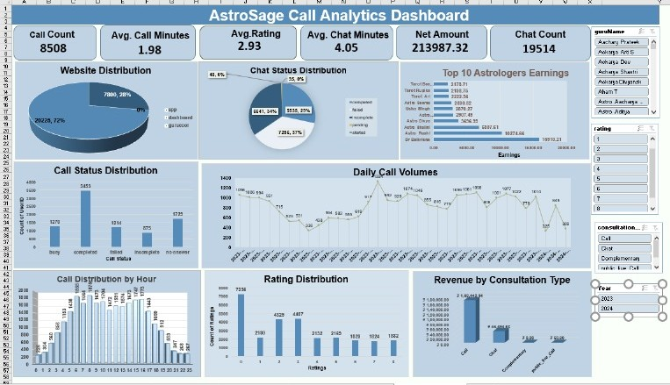
Astrosage dashboard

Slide 14
Suggestion
Suggestions for Improvement Based on Findings
Agent training:
Focus training on areas that correlate with high satisfaction, such as consultation effectiveness or reduced resolution time.
Optimization of call duration:
Identify the optimal duration range where satisfaction is highest and aim for efficiency within that range.
Feedback integration:
Use customer feedback to identify pain points and success areas for iterative improvement.
Strategic resource allocation:
Deploy high-performing agents during critical time slots or for complex cases to maintain satisfaction levels.

Slide 15
Based on call centre operations, the following data attributes might impact customer satisfaction:
Call duration: shorter or optimal durations may indicate efficient resolution.
Agent performance: metrics like the number of calls handled, agent rating, and expertise (e.g., Guru name).
Call channel and type: free vs. Paid calls, chat vs. Voice calls, or specific consultation types.
Call status: successful resolution or unresolved queries (e.g., Refund or escalation cases).
Time of call: off-peak vs. Peak handling efficiency.
Region: localization or language support preferences.

Slide 16
Conclusion
By addressing key gaps through technology upgrades, targeted training, and performance-driven incentives, AstroSage can significantly enhance operational efficiency and customer satisfaction. Implementing CRM, AI routing, and analytics tools, along with the Guru Excellence Program, will ensure consistent quality and reduced repeat calls.
With these strategic steps, AstroSage is well-positioned to achieve a balanced workload, improved CSAT, and sustainable profitability — transforming current challenges into opportunities for growth and long-term success.

Slide 17
THANK YOU

